Slide 1
PRIMs tutorial
Unit 2: Variable binding and multiple skills

Slide 3
Multiple Skills
Sometimes we need more than one Skill to do a task, or we want to model multitasking
In PRIMs, we can have multiple active skills

Slide 4
Operator associations
Start-Count
Goal
Count
Daydream
Iterate
Final

Slide 5
Implementation
You can set more than one skill as part of the task:
initial-skills: (read-equation transform arithmetic)
You can add/change skills using PRIMs:
transform -> G2

Slide 6
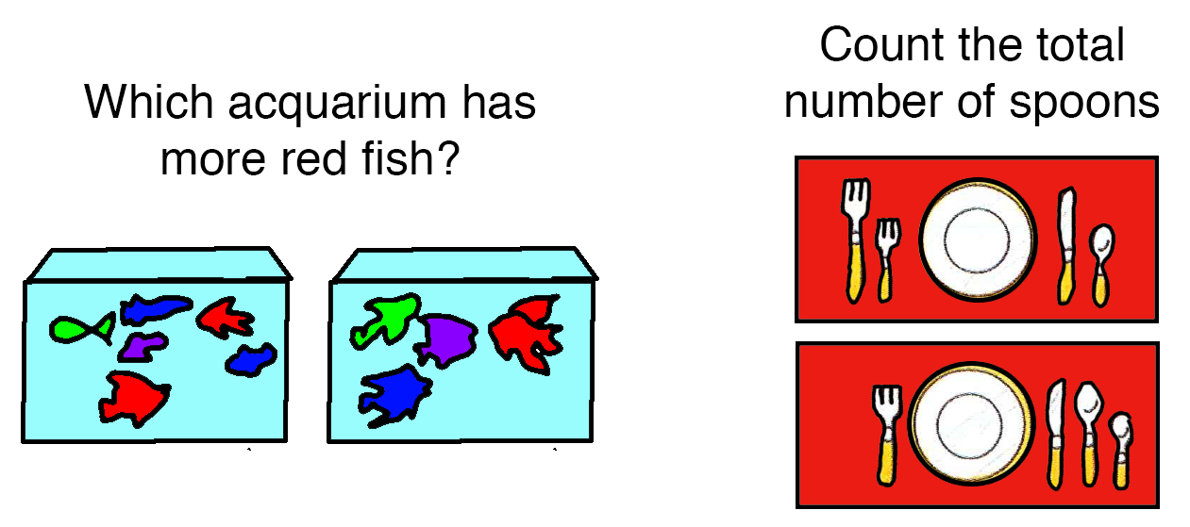
How to make goals more flexible?

Slide 7
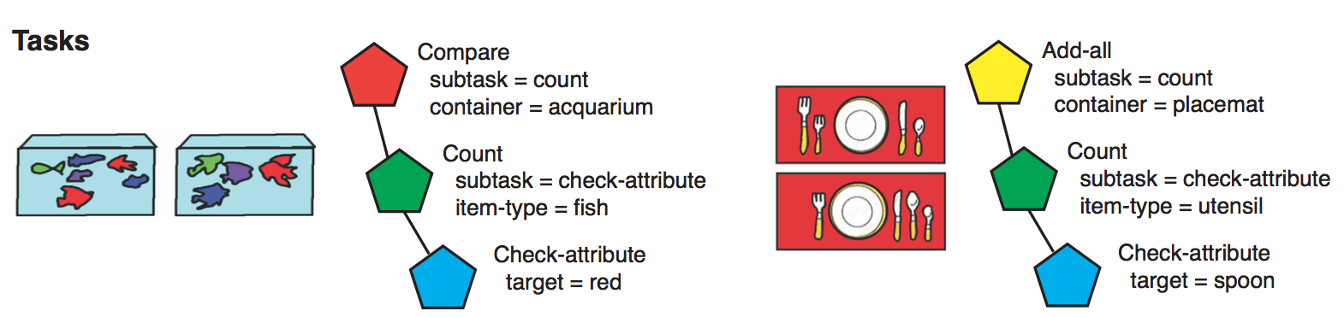
What we want is

Slide 8
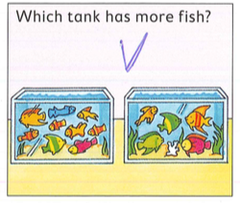
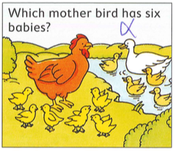
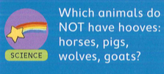
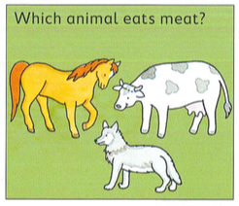
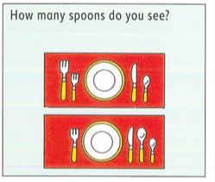

Slide 9
In Unit 1
operator start-count {
V1 <> nil
WM1 = nil
==>
V1 -> WM1
count-fact -> RT1
V1 -> RT2
say -> AC1
V1 -> AC2
}
operator start-semantic {
V1 <> nil
WM1 = nil
==>
V1 -> WM1
property -> RT1
V1 -> RT2
subvocalize -> AC1
V1 -> AC2
}

Slide 10
Under the hood
operator start-count {
V1 <> nil
WM1 = nil
==>
V1 -> WM1
C1 -> RT1
V1 -> RT2
C2 -> AC1
V1 -> AC2
}
C1 = count-fact
C2 = say
operator start-semantic {
V1 <> nil
WM1 = nil
==>
V1 -> WM1
C1 -> RT1
V1 -> RT2
C2 -> AC1
V1 -> AC2
}
C1 = property
C2 = subvocalize

Slide 11
In Unit 1
operator start-count {
V1 <> nil
WM1 = nil
==>
V1 -> WM1
count-fact -> RT1
V1 -> RT2
say -> AC1
V1 -> AC2
}
operator start-semantic {
V1 <> nil
WM1 = nil
==>
V1 -> WM1
property -> RT1
V1 -> RT2
subvocalize -> AC1
V1 -> AC2
}

Slide 12
Better: Introduce variables
operator start {
V1 <> nil
WM1 = nil
==>
V1 -> WM1
*fact-type -> RT1
V1 -> RT2
*action -> AC1
V1 -> AC2
}
Variables start with a *
You give a variable a value with an action, e.g. WM1 -> *fact-type say -> *action
Or you can set variables in the script, e.g. add-binding(“action”, “say”)

Slide 13
Implementation of variables
Two options:
Through a special bindings buffer (currently the default)
Through declarative memory:
-> *variable adds a chunk to DM
Using a variable retrieves a chunk from DM
Second option has costs, and probability of failure
bindings-in-dm: t

Slide 14
Update of other rules
operator iterate {
RT2 = WM1
V2 <> WM1
==>
RT3 -> WM1
count-fact -> RT1
RT3 -> RT2
say -> AC1
RT3 ->AC2
}
operator iterate {
RT2 = WM1
V2 <> WM1
==>
RT3 -> WM1
*fact-type -> RT1
RT3 -> RT2
*action -> AC1
RT3 ->AC2
}

Slide 15
operator final {
V2 = WM1
==>
say -> AC1
stop -> AC2
nil -> G1
}
operator final {
V2 = WM1
==>
*final-action -> AC1
*final-response -> AC2
nil -> G1
}

Slide 16
One extra rule: what to do on failure
operator final-fail {
V2 <> WM1
RT1 = error
==>
*final-action -> AC1
*final-response-negative -> AC2
}

Slide 17
Specify bindings by instantiating skills in the script
add-binding("fact-type","count-fact")
add-binding("action","say")
add-binding("final-action","say")
add-binding("final-response","stop")
add-binding("fact-type","property")
add-binding("action","sub-vocalize")
add-binding("final-action","say")
add-binding("final-response","yes")
add-binding("final-response-negative","no")

Slide 18
A nice first step
We can reuse the whole skill for two different tasks
But it cannot be part of a larger task, because it has both the perception and the action included

Slide 19
New iteration: split up the skill
Counting (or semantic reasoning) should be independent from the particulars of the input and what you do with the result
Therefore: split up the counting (and semantic) task into three skills:
Read
Iterate
Respond

Slide 20
Read skill
define skill read {
operator read-for-two-items {
V1 <> nil
V2 <> nil
WM1 = nil
==>
V1 -> WM1
V2 -> WM2
}
operator switch-to-next-skill {
V1 = WM1
==>
*next-skill -> G1
}
}

Slide 21
Iterate skill now uses WM as input
operator start-iteration {
WM3 = nil
==>
WM1 -> WM3
*fact-type -> RT1
WM1 -> RT2
*action -> AC1
WM1 -> AC2
}
operator iterate {
RT2 = WM3
WM2 <> WM3
==>
RT3 -> WM3
*fact-type -> RT1
RT3 -> RT2
*action -> AC1
RT3 ->AC2
}

Slide 22
Final operator passes control on to the next skill
operator final {
WM2 = WM3
==>
*final-action-skill -> G1
}
operator final-fail {
WM2 <> WM3
RT1 = error
==>
*fail-skill -> G1
}

Slide 23
Respond skill
define skill respond {
operator carry-out-action {
G1 <> nil
==>
*action -> AC1
*arg -> AC2
nil -> G1
}
}

Slide 24
Now instantiate and link together
add-binding("next-skill","iterate")
add-binding("action","say")
add-binding("fact-type","count-fact")
add-binding("final-action-skill","respond")
add-binding("respond-action","say")
add-binding("respond-arg","stop")

Slide 25
For semantic, we have a problem
We would like two copies of the ”respond” skill, one for “yes”, and one for “no”
This is a typical subproblem of the binding problem
Flexibilty vs. Simplicity

Slide 26
For now, we choose simplicity
define skill respond {
operator carry-out-action {
G1 <> nil
==>
*respond-action -> AC1
*respond-arg -> AC2
nil -> G1
}
}
define skill alt-respond {
operator carry-out-action {
G1 <> nil
==>
*alt-respond-action -> AC1
*alt-respond-arg -> AC2
nil -> G1
}
}

Slide 27
Bindings for semantic
add-binding("next-skill","iterate")
add-binding("action","sub-vocalize")
add-binding("fact-type","property")
add-binding("final-action-skill","respond")
add-binding("fail-skill","alt-respond")
add-binding("respond-action","say")
add-binding("respond-arg","yes")
add-binding("alt-respond-action","say")
add-binding("alt-respond-arg","no")

Slide 28
A final improvement
Iteration still includes a “primitive” action (such as “say” or “subvocalize”)
It would be nice if this would be more flexible
Solution: hand over control to another skill on each iteration

Slide 29
Modify the iterate skill
operator start-iteration {
WM3 = nil
==>
WM1 -> WM3
*sub-skill -> G1
}
define skill do-action {
operator do-action-on-WM3 {
WM3 <> nil
==>
*action -> AC1
WM3 -> AC2
*main-skill -> G1
}
}

Slide 30
Need two operators to handle the iteration
operator retrieve-next {
RT1 = nil
WM3 <> nil
WM2 <> WM3
==>
*fact-type -> RT1
WM3 -> RT2
}
operator do-sub-skill {
RT1 = *fact-type
==>
RT3 -> WM3
*sub-skill -> G1
}

Slide 31
Final operators are the same
operator final {
WM2 = WM3
RT1 = nil
==>
*final-action-skill -> G1
}
operator final-fail {
WM2 <> WM3
RT1 = error
==>
*fail-skill -> G1
}
}

Slide 32
Instantiation of the skills
add-binding("next-skill","iterate")
add-binding("action","say")
add-binding("fact-type","count-fact")
add-binding("final-action-skill","respond")
add-binding("respond-action","say")
add-binding("respond-arg","stop")
add-binding("sub-skill","do-action")
add-binding("action","say")
add-binding("main-skill","iterate")

Slide 33
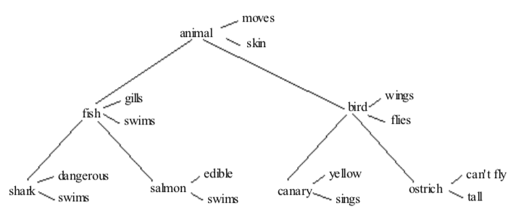
How to use this new flexibility?
Implement the full semantic task

Slide 34
In the attempt-retrieve sub-skill we check the attribute
operator start-retrieve {
WM2 <> nil
WM3 <> nil
RT1 = nil
==>
*fact-type -> RT1
WM3 -> RT2
WM2 -> RT3
}
operator on-success {
RT1 = *fact-type
==>
*success-skill -> G1
}
operator on-fail {
RT1 = error
==>
*fail-skill -> G1
}

Slide 35
Assignment
Instantiate the necessary skills in the script of semantic-rev3.prims to finish the model

Slide 36
Application: Why and when do people multitask?
Multitasking, not single tasking, is the natural way of cognition
Whenever people have unused brain resources, they will try to put them to use

Slide 37

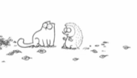
Competition between skills and other inputs for operator priority
Goals
Write paper
Email
Senses
Memory
Taatgen, N.A. (2013). The nature and transfer of cognitive skills. Psychological Review, 120(3), 439-471.

Slide 38
Thinking never stops
The system keeps executing operators, whether or not they are relevant for the task

Slide 39
Setup: complex WM task
Subjects have to remember a sequence of letters
However, between the letters, words are presented to which they need to respond
Words are personality traits (“Aggressive”, “Emotional”, “Shy”), or objects (“Table”, “Spoon”)
Two conditions:
Does this trait apply to you?
Does it fit in a shoebox?

Slide 40
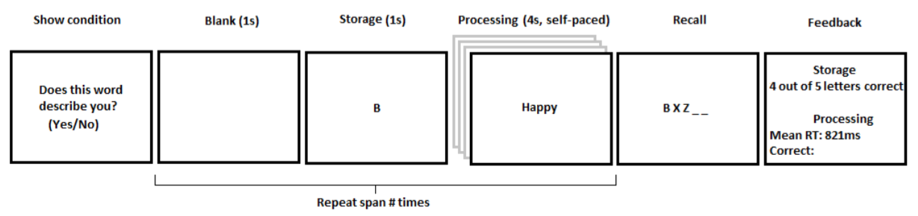

Slide 41
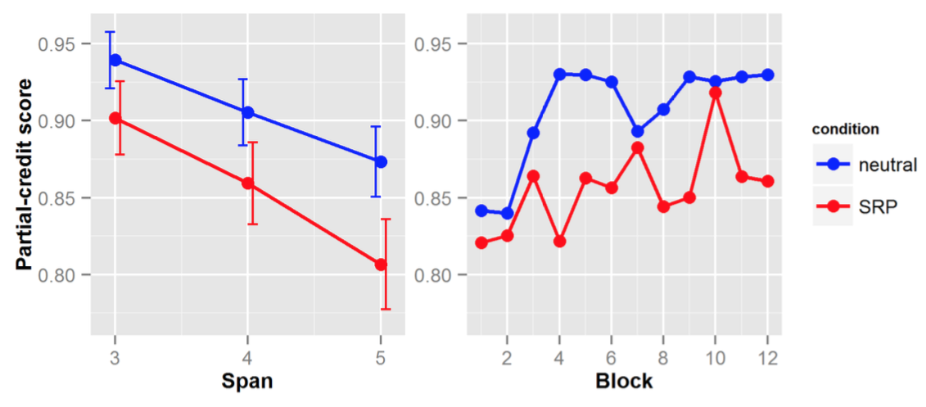
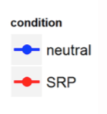
Results

Slide 42
Model
The complex working memory task requires several goals
Memorize the letters
Process and respond to words
Rehearse
Memory retrieval of a self-referential word is a source of distraction
Transitions between goals are “weak points”, and are open to distraction

Slide 51
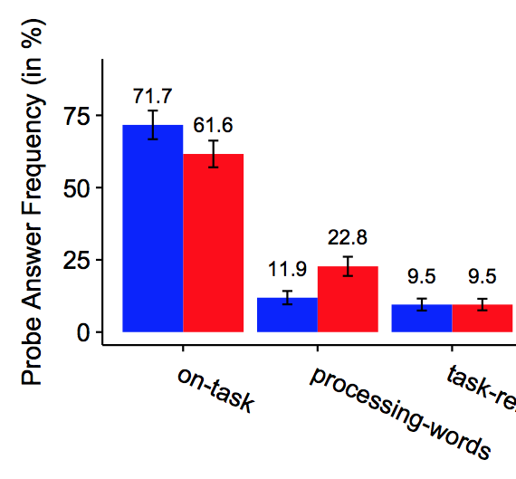
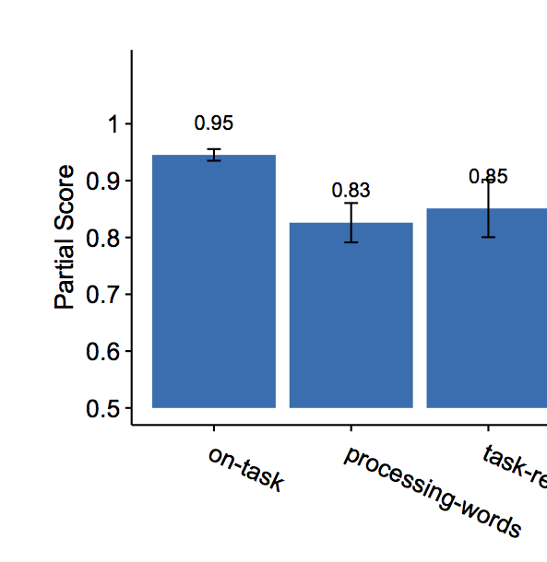
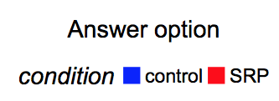

Slide 52
Discussion
Even a mild distraction can reduce our working memory capacity!
Distraction is caused by “internal distractors”
Stefan has collected more data (though-probes, eye-data) to support this

Slide 53

Visual distraction

Slide 54
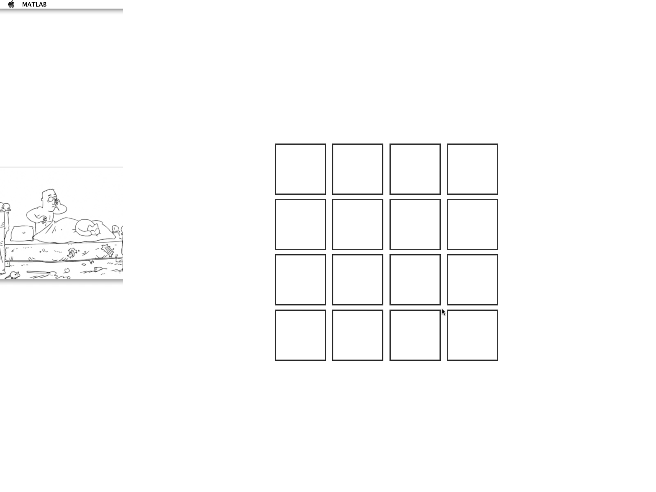
Visual distraction

Slide 55
Three conditions
Easy: 3 + 5 = X
Medium: X + 5 = 14
Hard: 3X – 5 = 13

Slide 56
Guess the outcome!
Distraction increases with the difficulty of the main task
Distraction is not affected by difficulty
Distraction decreases with the difficulty of the main task

Slide 57
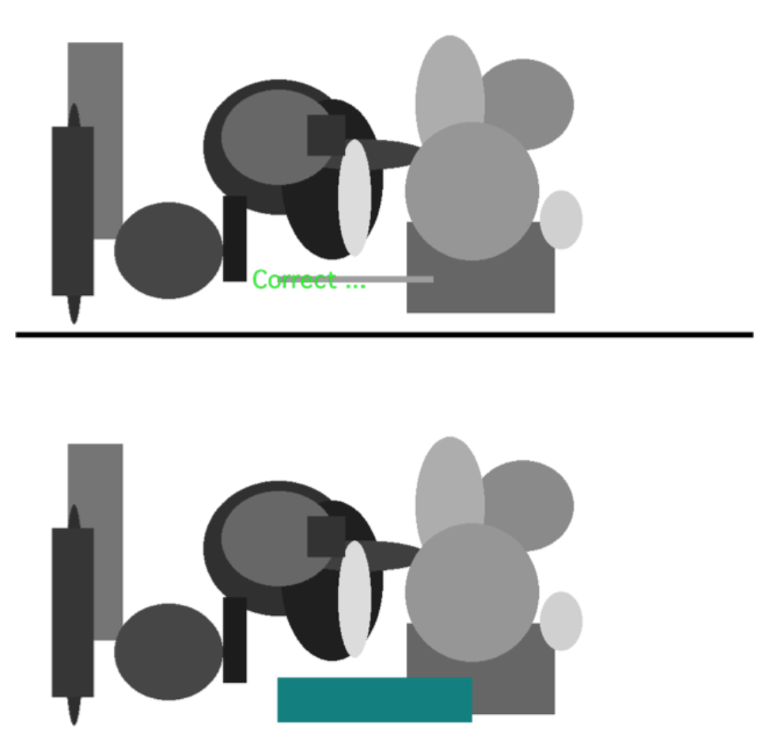
Second experiment: Find the difference
Easy: 2-4 shapes
Medium: 15-17 shapes
Hard: 40-42 shapes

Slide 58
Guess the outcome!
Distraction increases with the difficulty of the main task
Distraction is not affected by difficulty
Distraction decreases with the difficulty of the main task

Slide 59
Results

Slide 60
Overview of the simulation
Goal
Memory
Equation
Vision
Memory

Slide 61
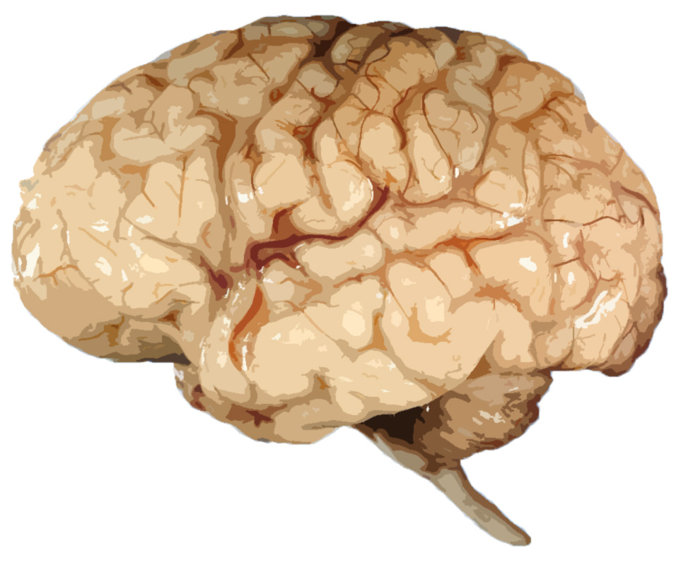
Read
Working
memory
Goals
Transform
Arithmetic
Long
Term
memory
5x + 2 = 12
Visual

Slide 62
Read
Working
memory
Goals
Transform
Arithmetic
Long
Term
memory
5x + 2 = 12
Visual

Slide 63
Read
Working
memory
Goals
Transform
Arithmetic
Long
Term
memory
5x
5x + 2 = 12
5x
Visual

Slide 64
Read
5x
Working
memory
Goals
Transform
Arithmetic
Long
Term
memory
5x + 2 = 12
5x
Visual

Slide 65
Read
5x
5x + 2
Working
memory
Goals
Transform
Arithmetic
Long
Term
memory
5x + 2 = 12
+2
5x
Visual

Slide 66
Read
5x
5x + 2 = 12
5x = 12 – 2
Working
memory
Goals
Transform
Arithmetic
Long
Term
memory
5x + 2 = 12
Visual

Slide 67
Read
5x
5x + 2 = 12
5x = 12 – 2
Working
memory
Goals
Transform
Arithmetic
Long
Term
memory
5x + 2 = 12
Visual

Slide 68
Read
5x
5x + 2 = 12
5x = 12 – 2
Working
memory
Goals
Transform
Arithmetic
Long
Term
memory
5x + 2 = 12
12 – 2 = ?
Visual

Slide 69

Why is there more distraction for hard equations?
x = 3 + 4
x + 1 = 5
5x + 2 = 12
Read x =
Read x + 1
Read 5x
Read x = 3
Read x + 1
Read 5x + 2
Read x = 3 + 4
Read x + 1 = 5
Read 5x + 2 = 12
3 + 4 = ?
==> x = 5 – 1
==> 5x = 12 – 2
3 + 4 = 7
5 – 1 = ?
12 – 2 = ?
5 – 1 = 4
5x = 10
==> x = 10/5
10/5 = ?
10/5 = 2

Slide 70
Search de verschillen
Search
Working
memory
Goals
Compare
Long
Term
memory
Visual

Slide 71
Search
Working
memory
Goals
Compare
Long
Term
memory
Visual

Slide 72
Search
Working
memory
Goals
Compare
Long
Term
memory
Visual

Slide 73
Search
Working
memory
Goals
Compare
Long
Term
memory
Visual

Slide 74
Search
Working
memory
Goals
Compare
Long
Term
memory
Visual

Slide 75
Main model principle
goal
Read
Transform
Arithmetic
Answer
visual
Cat movie

Slide 76
Model of Memory Game
Visual distraction can only intervene if the visual buffer is empty, and during transitions between goals

Slide 77
Why is there more distraction for hard equations?
x = 3 + 4
x + 1 = 5
5x + 2 = 12
Read x =
Read x + 1
Read 5x
Read x = 3
Read x + 1
Read 5x + 2
Read x = 3 + 4
Read x + 1 = 5
Read 5x + 2 = 12
3 + 4 = ?
==> x = 5 – 1
==> 5x = 12 – 2
3 + 4 = 7
5 – 1 = ?
12 – 2 = ?
5 – 1 = 4
5x = 10
==> x = 10/5
10/5 = ?
10/5 = 2

Slide 78
Model of find-the-differences
Visual distraction competes with other unattended visual items

Slide 79
Model results

Slide 80
General explanation for distraction
If a cognitive resource is not used by the main task, distracting elements can “grab” it
In the memory task, harder means less vision
In the find-the-differences task, harder means more vision
A distraction can turn into a full-blown distraction if it manages to recruit more resources

Slide 81
Conclusion
Distraction, mind wandering, and task reflection use the same mechanisms to interact with a main task
Distraction targets unused resources, and can recruit more if given an opportunity

